Slide 1
BlackList
Mohammad Zaed Iqbal Khan
Absara Chowdhury
Farhan Ishrak Tahmid

Slide 2
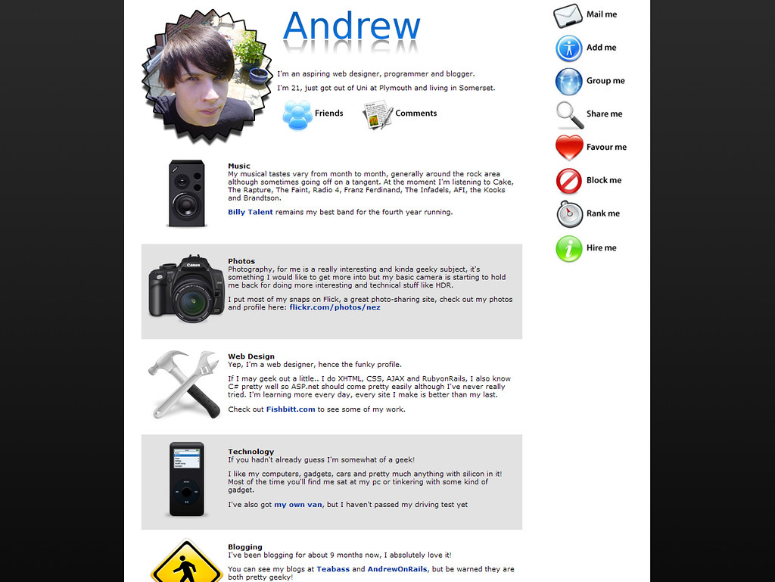

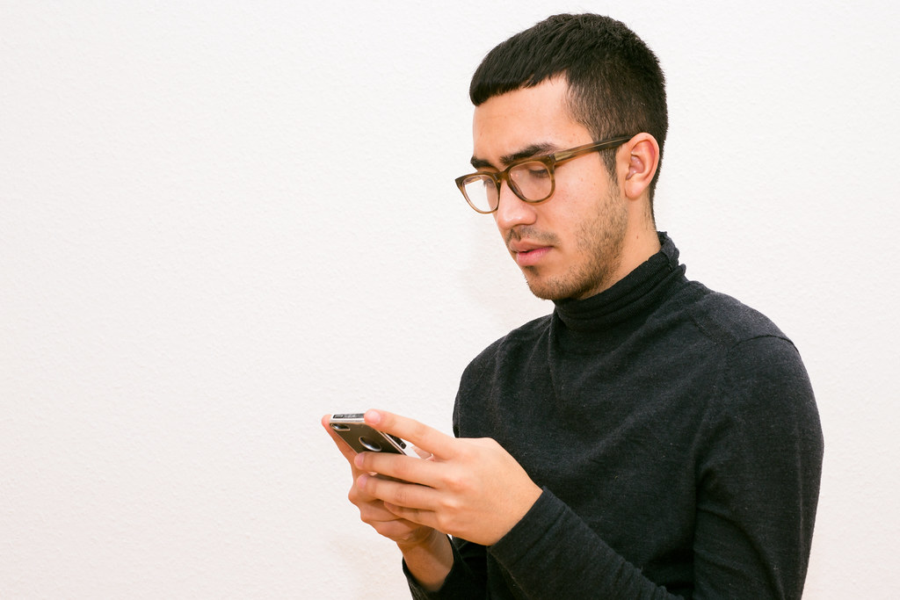
WHAT IS BLACKLIST?
Stops cyberbullying
Platform to report
Permanent Record

Slide 3
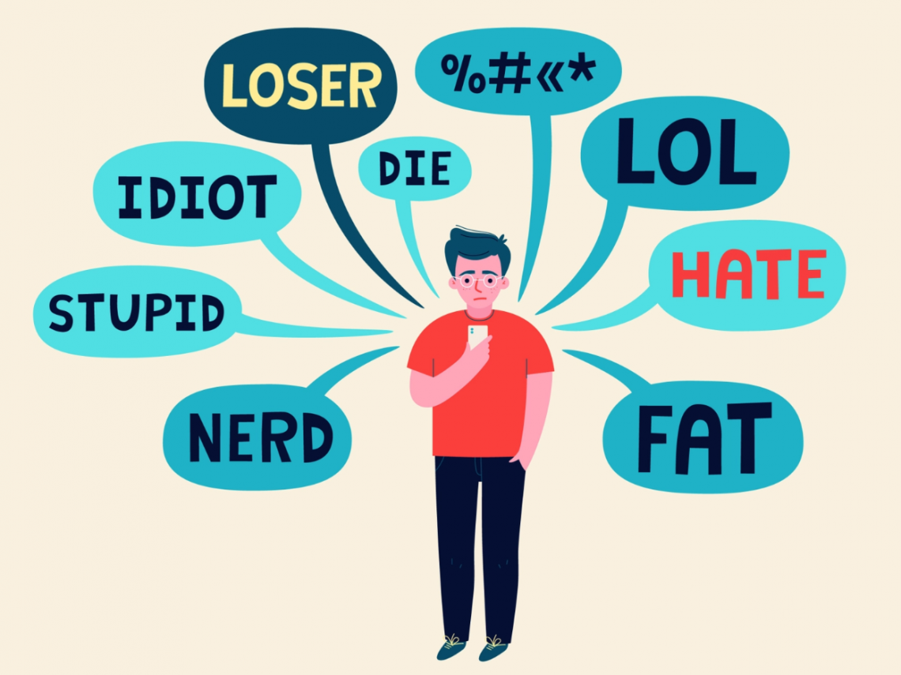
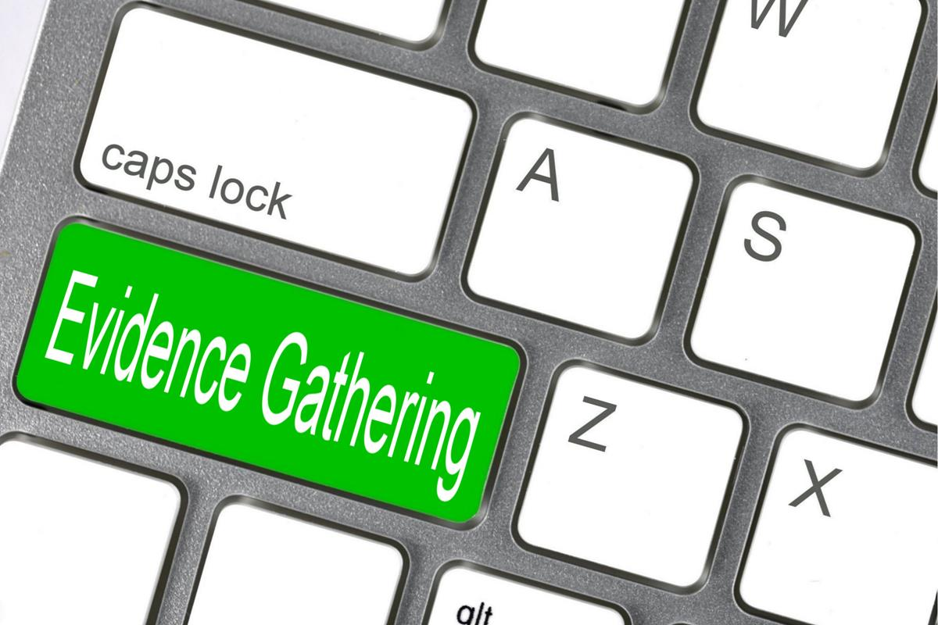

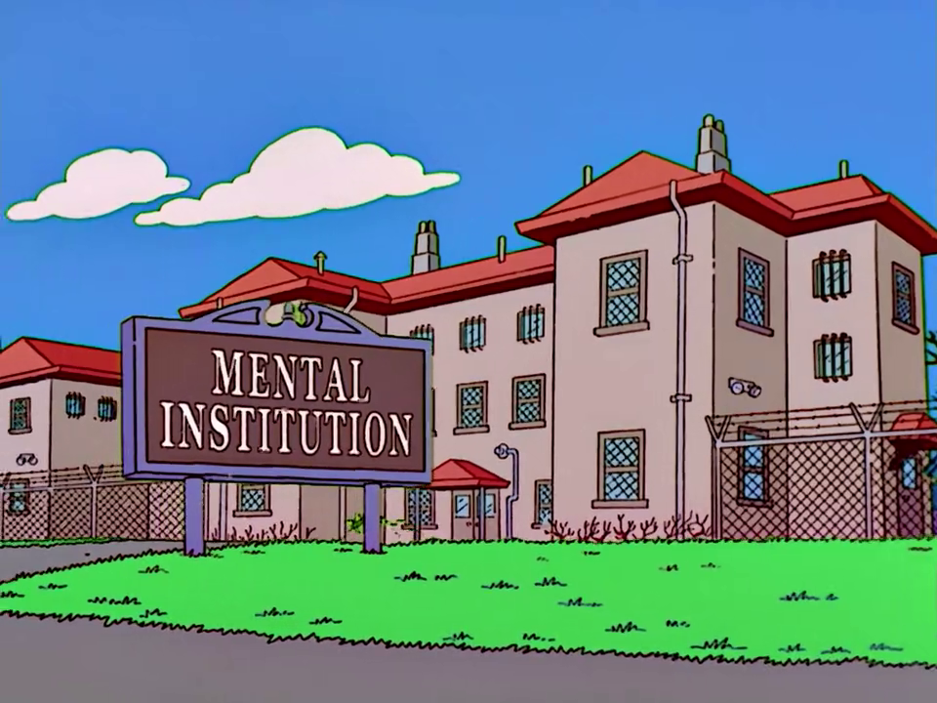
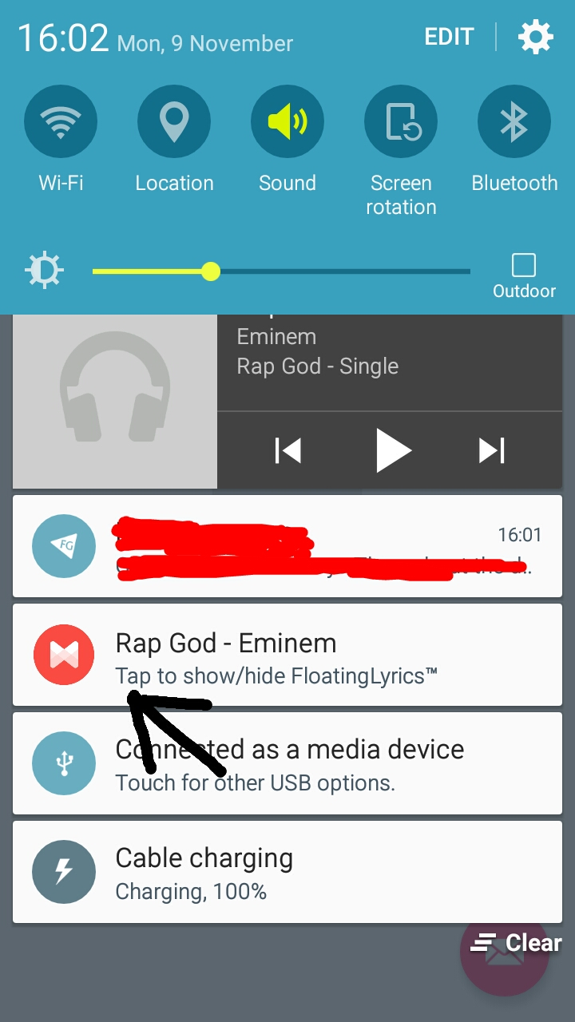
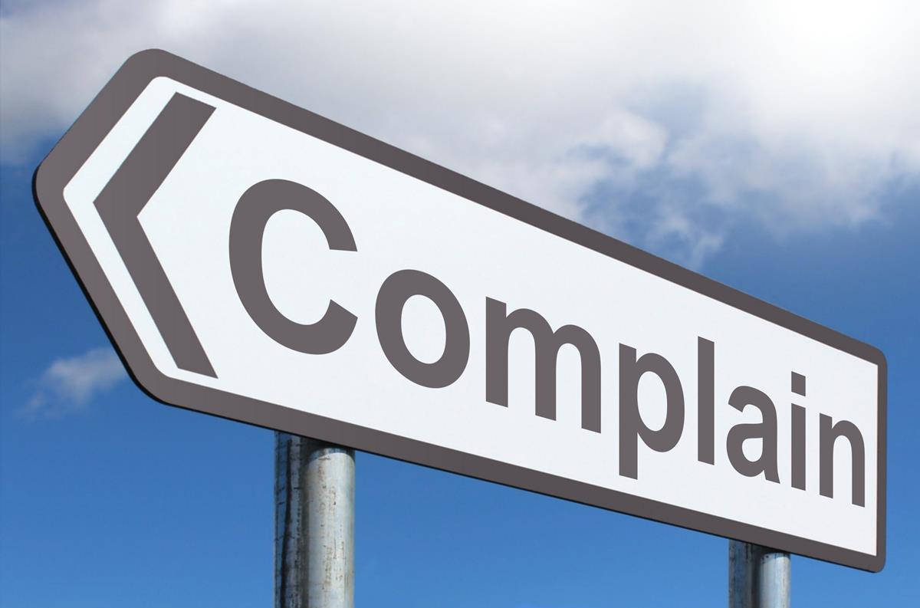
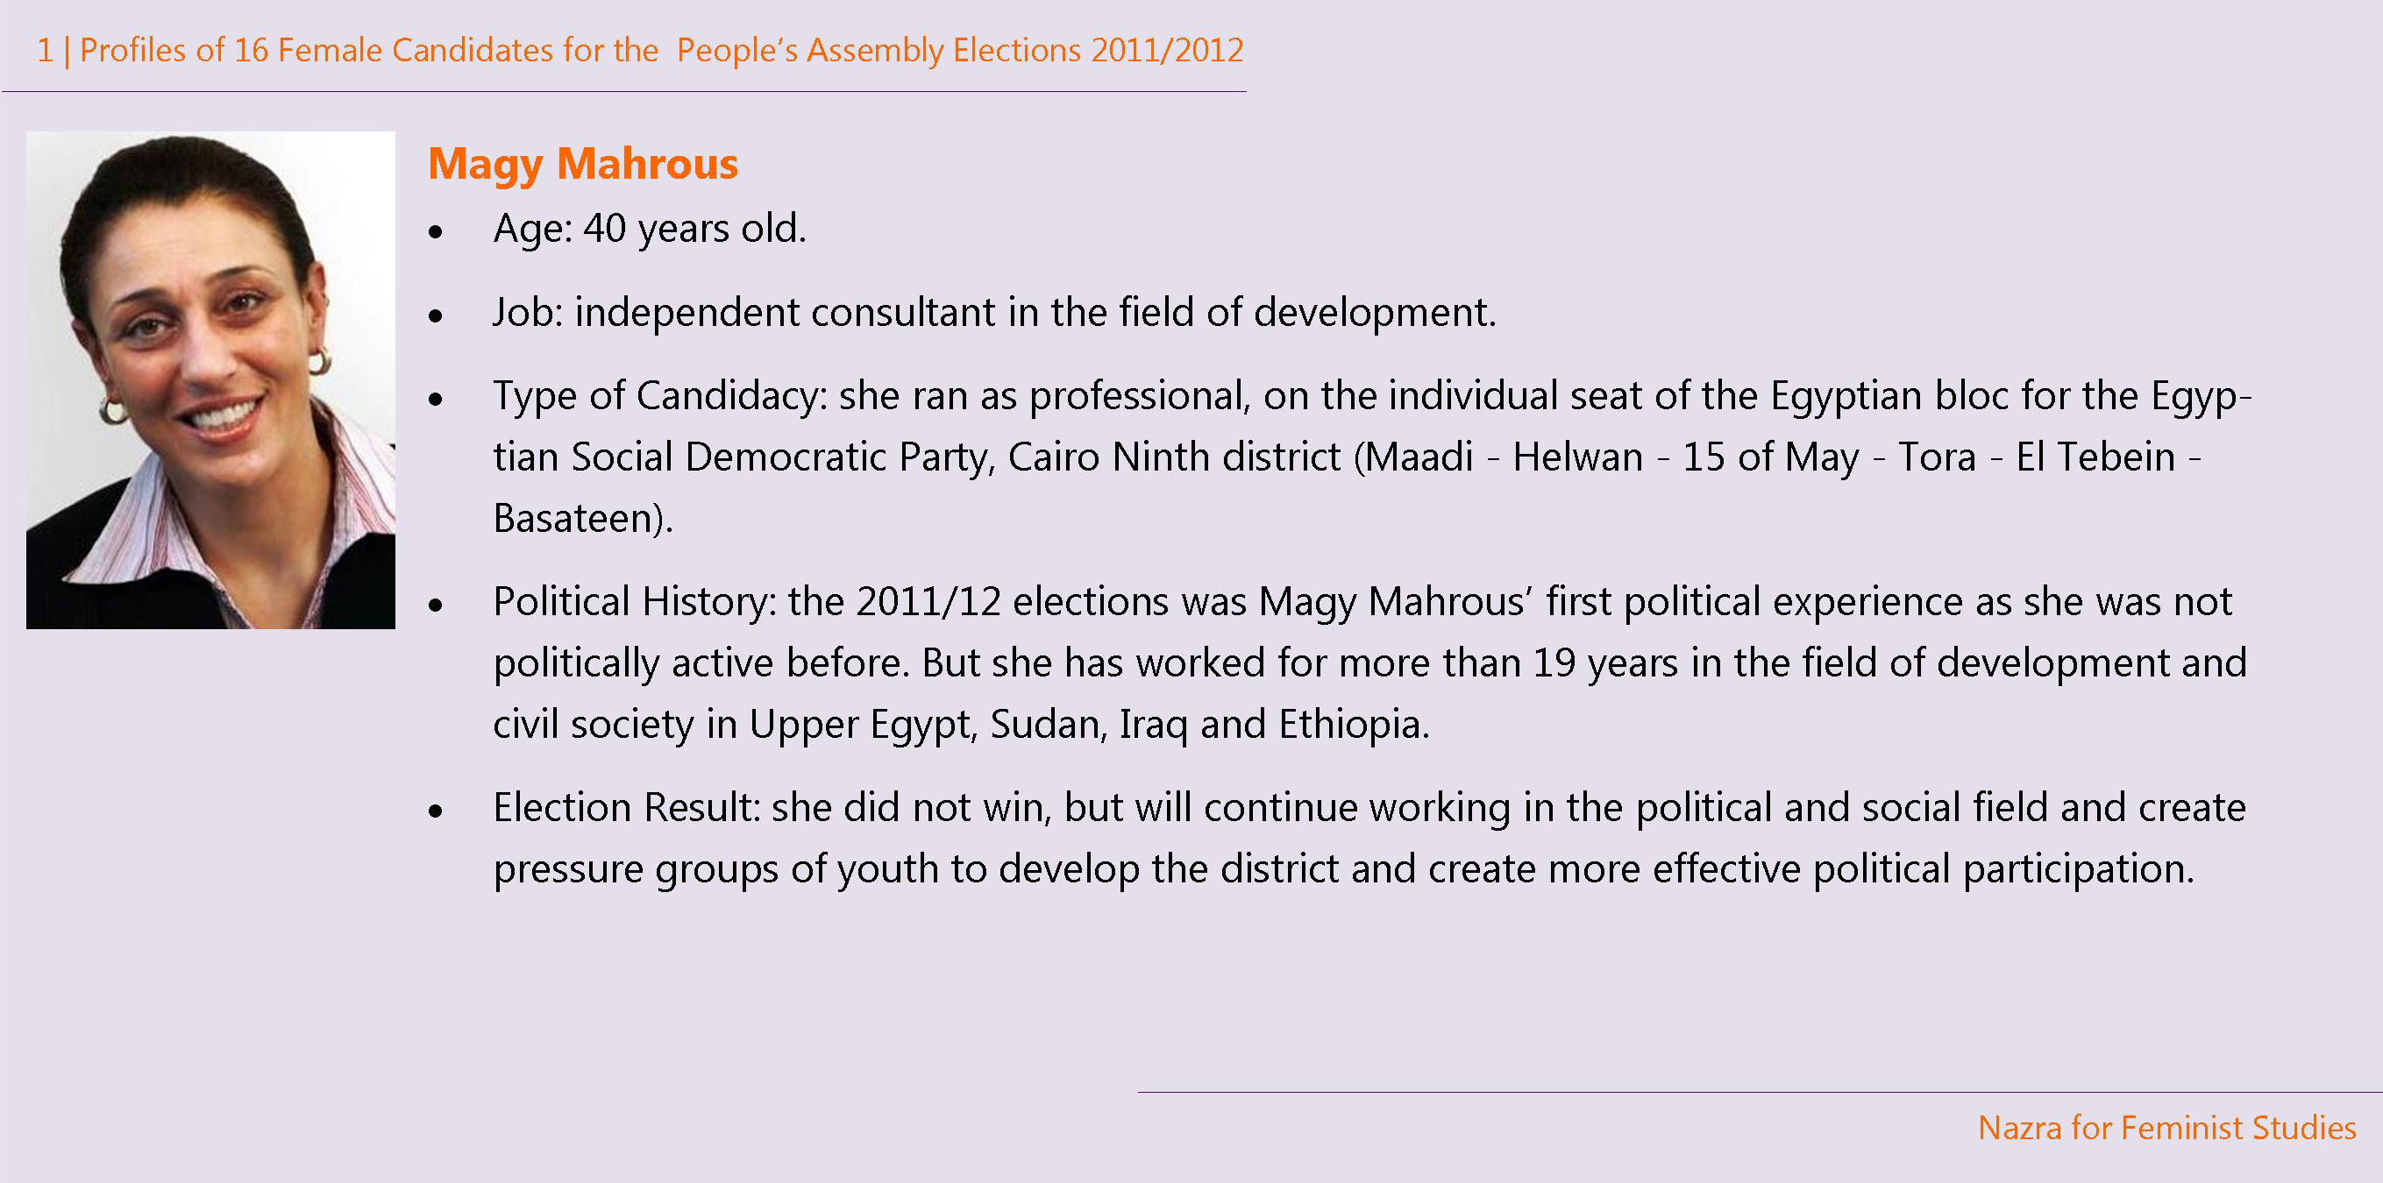

Slide 4
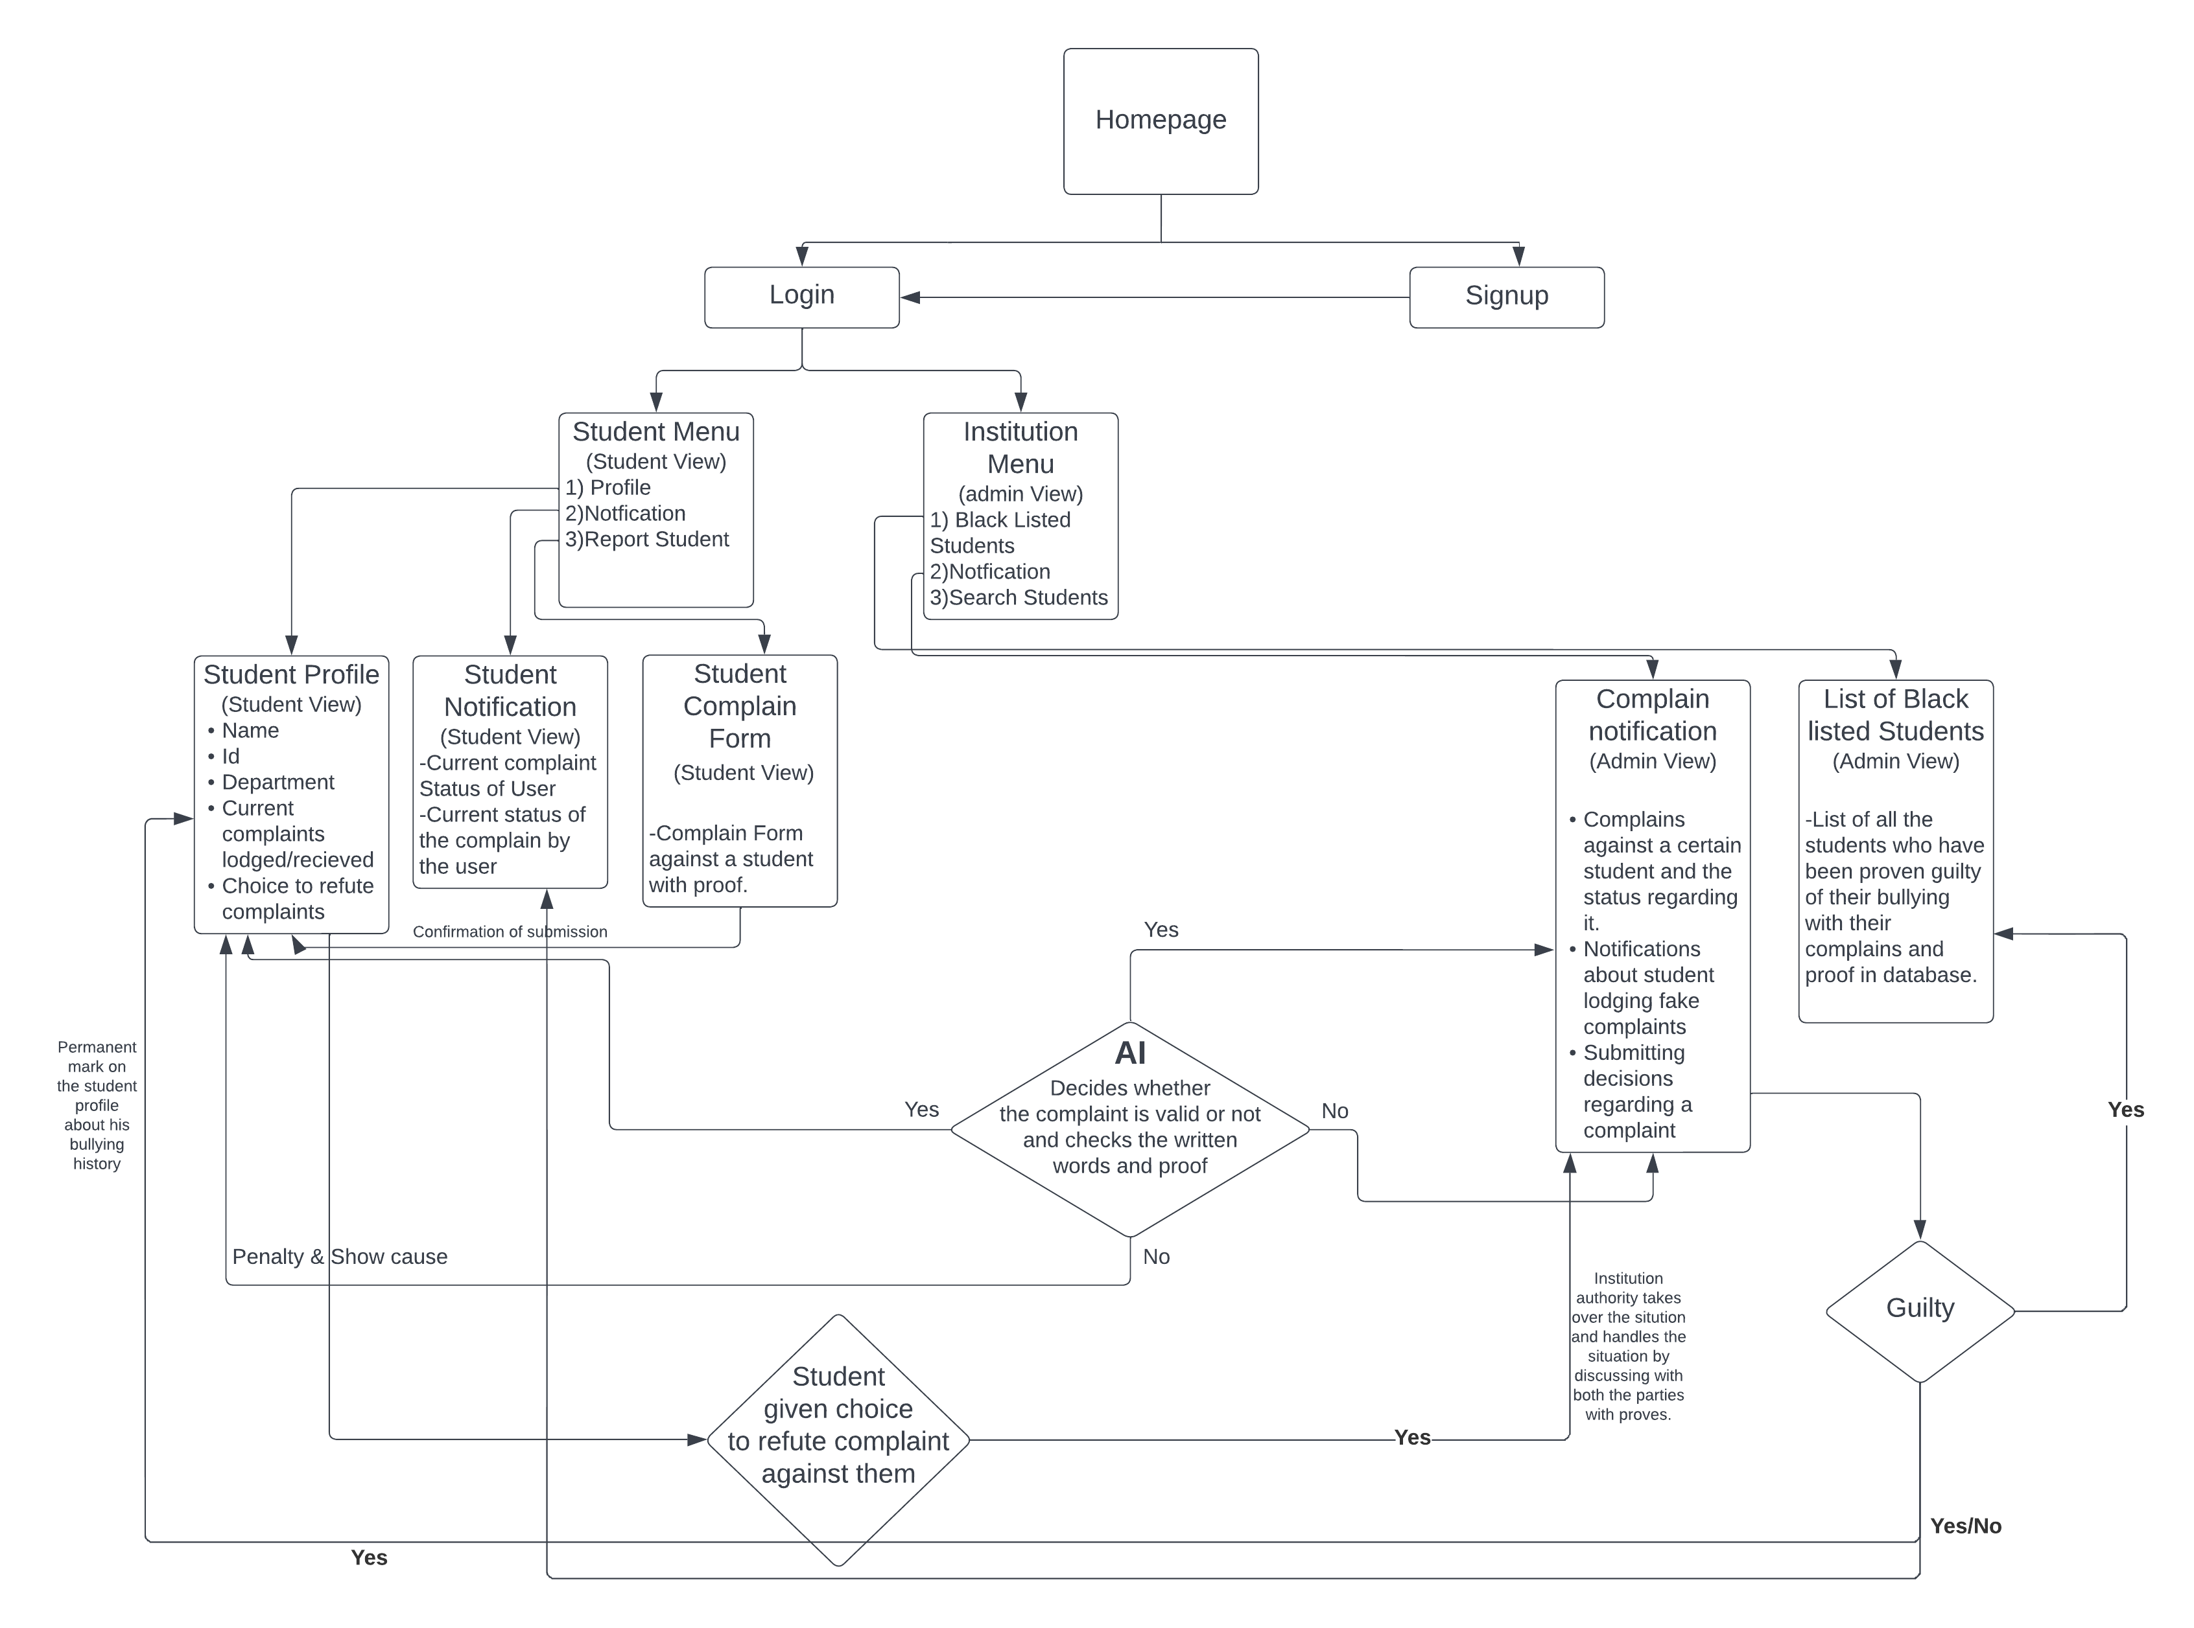
System Architechture

Slide 5
How It Reduces Cyberbullying
Provides platform for victims to raise voice
Allows victims to report anonymously
With evidence, allows institutions to punish bullies
Stores permanent records, acting as a deterrent to future cyberbullies
Nobody wants to bully if they know it will impact their future/career

Slide 6
Business Model
Target Audience: students of educational institutions
Lease the application to the institutions on a yearly subscription basis
Generate revenue by ads
Freemium model

Slide 7


Slide 8
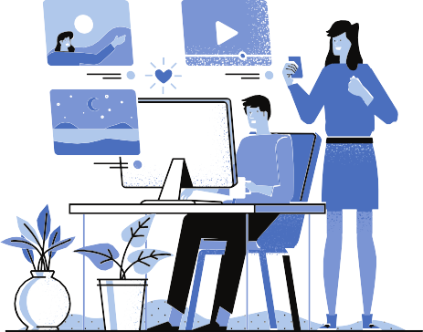
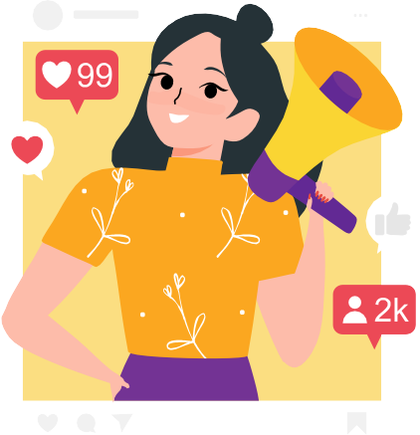



SOCIAL MEDIA
POSTS (facebook, instagram)
INFLUENCE MARKETING
( influencer, celebrities)
3
1
Video content (youtube, facebook,instagram)
2
HASHTAGS
(facebook, instagram)
4

Slide 9
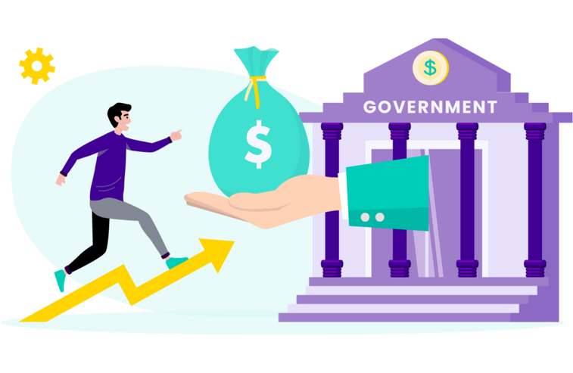


Future Plan
Investors
Launch on Playstore/Appstore
Government Support

Slide 10


